Slide 1
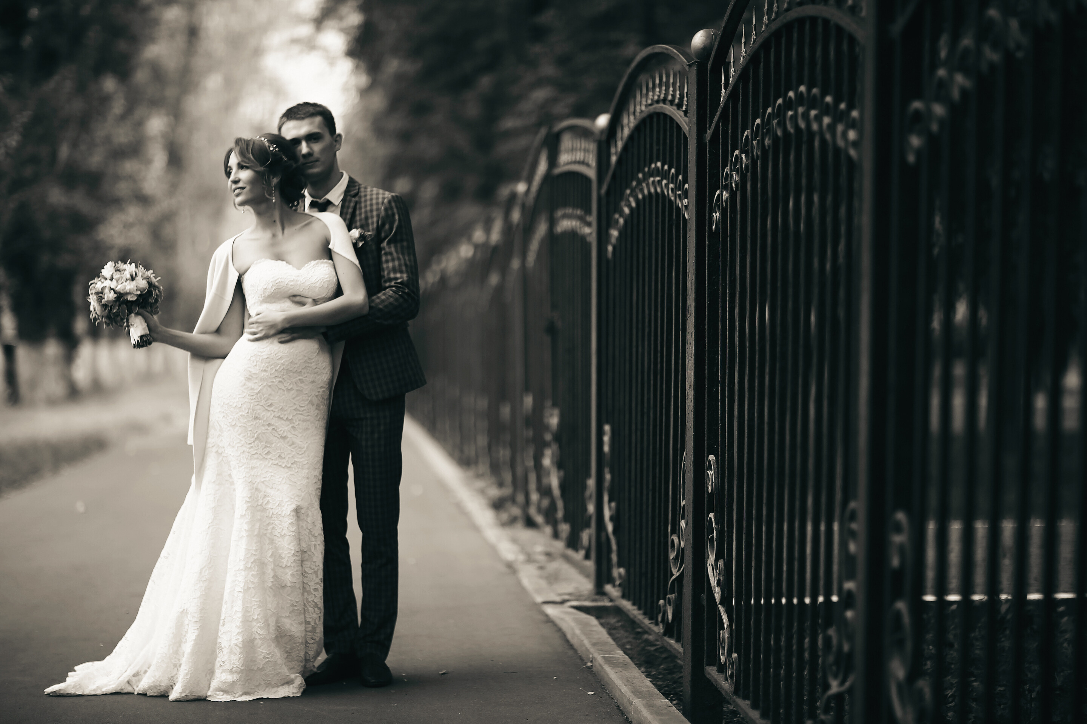
WELCOME TO THE WEDDING OF
OLIVIA WHITE
&
OLIVER BLACK
23.07.2026
THANK YOU FOR CELEBRATING WITH US!

